Slide 1
THE ONTARIO PRO-CON DEBATE FORUM
Established 1960
ONLINE DEBATE TOURNAMENT

Slide 2
Thank You for Volunteering
Normally, one PRO-CON (or cross-examination) debate requires approximately an hour to stage. It consists of three main activities: speeches, cross-examination questioning, and rebuttals, producing a debate of approximately 50-60 minutes. League debates use one judge per room to determine a winning team.

Slide 3
Tournament Schedule
8:30 to 9:00 - Sign in for Registration (Timekeepers and Students and judges will check off their names on a Google doc below)
9:00 to 10:00 - Briefing for Judges and Debaters
10:00 to 11:00 - Round One (prepared)
11:00 to 12:00 - Lunch and preparation for Round Two (impromptu)
12:00 to 1:00 - Round Two
1:30 - Announcement of Results

Slide 4
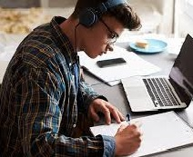
Online Tournament Reminders
Make sure you have an updated version of Zoom.
You must use your real name on Zoom.
No recording or screenshots during debates.
Debaters should have their cameras on when they are speaking, questioning, or being questioned.
If someone gets bumped out of Zoom, the judge can wait 5 minutes or a reasonable time.
If the debater cannot get into Zoom, call partner’s phone and put it on speakerphone.

Slide 5
To change your name on Zoom:
Click Participants tab at bottom of screen
Beside your name on the right side of the screen, click More.
Click Rename. Put your surname first, then a comma, then your first name.
ZOOM LINK FOR DEBATE:
Da Costa, Michael (Brebeuf) is inviting you to a scheduled Zoom meeting.
https://tcdsb.zoom.us/j/95782507166
Meeting ID: 957 8250 7166

Slide 6
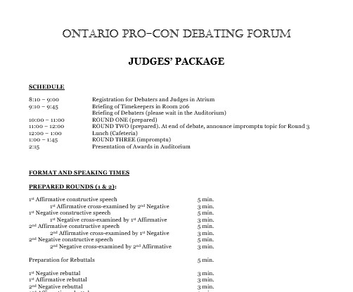
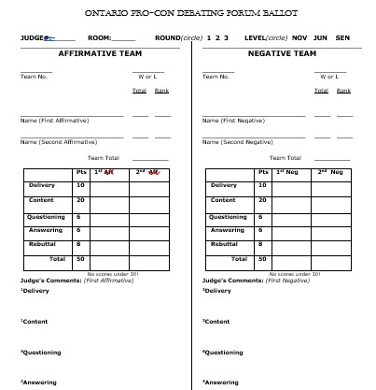
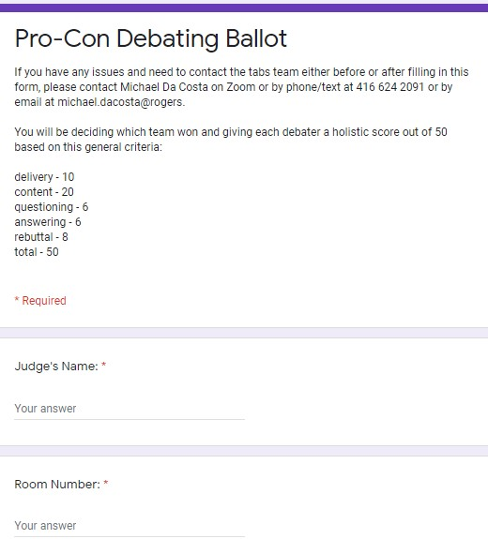
Debate Guidelines and Ballot

Slide 7
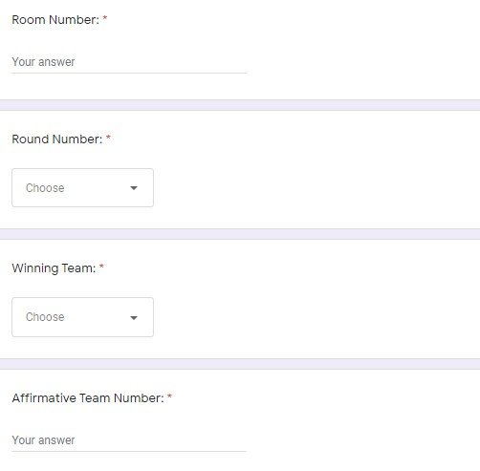

Slide 8
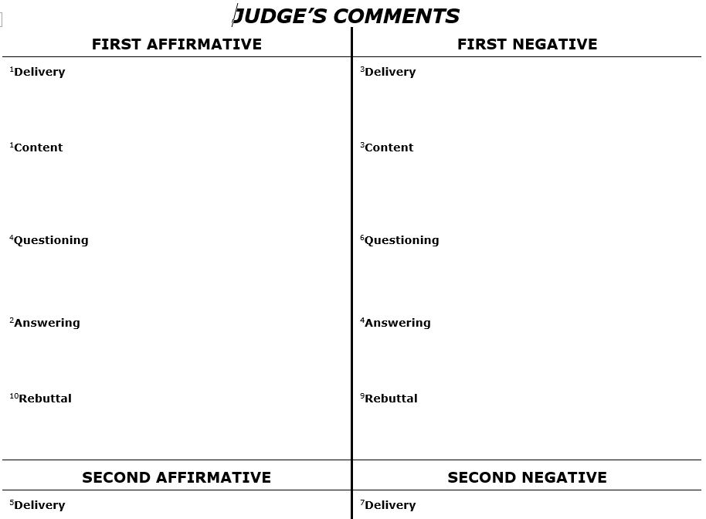

Slide 9
School teams…
Consist of 4 debaters, 2 on an affirmative side, 2 on a negative side.
Team sides remain AFF or NEG throughout three rounds of debate: no partner or side switches are allowed during tournaments.
1 rounds of prepared debate, 1 round of impromptu debate; produces 1 ballot per round.
1 adult registers, judges per team.

Slide 10
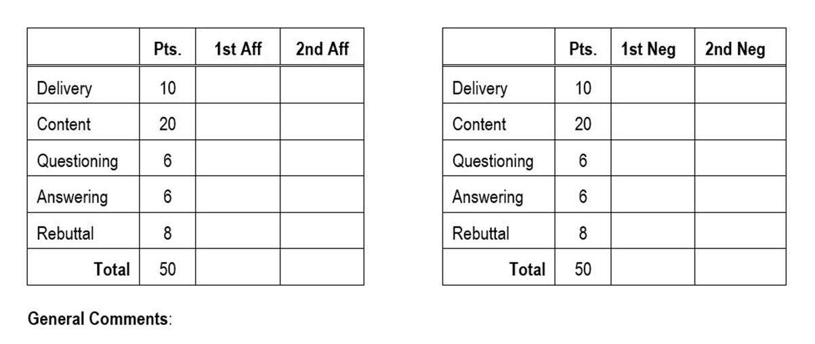

Slide 11
The order of speaking is as follows:
1st Affirmative constructive speech | 5 min.
1st Affirmative cross-ex. by 2nd Negative | 3 min.
1st Negative constructive speech | 5 min.
1st Negative cross-ex. by 1st Affirmative | 3 min.
2nd Affirmative constructive speech | 5 min.
2nd Affirmative cross-ex. by 1st Negative | 3 min.
2nd Negative constructive speech | 5 min.
2nd Negative cross-ex. by 2nd Affirmative | 3 min.
Preparation for Rebuttals | 5 min.
1st Negative rebuttal | 3 min.
1st Affirmative rebuttal | 3 min.
2nd Negative rebuttal | 3 min.
2nd Affirmative rebuttal | 3 min.

Slide 12
Defining the Terms of the Resolution
1st Affirmative starts debate by defining resolution, outlines terms of the debate, which are defined in reasonable, straightforward manner.
Not allowed to "squirrel" resolution (define it in such a way that it cannot actually be debated); cannot be defined in an outrageous, ridiculous, narrow manner (as in “BIRT We must defund the police”; then debaters define “police” as an 80’s rock band).

Slide 13
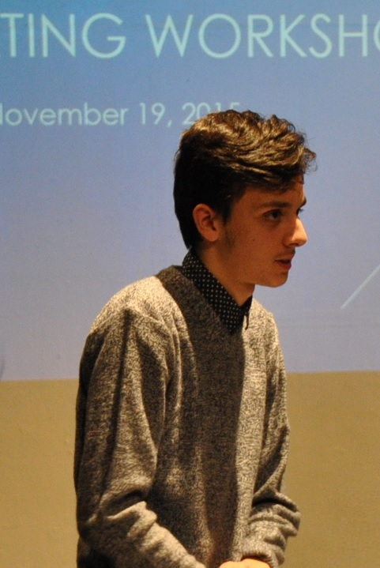
1st AFF also cannot define resolution broadly or in such a way that it becomes truism (statement that is undebatable because it is naturally true as in “BIRT the sky is blue”).
Debaters penalized if definitions inappropriately limiting, with maximum penalty being loss of debate.

Slide 14
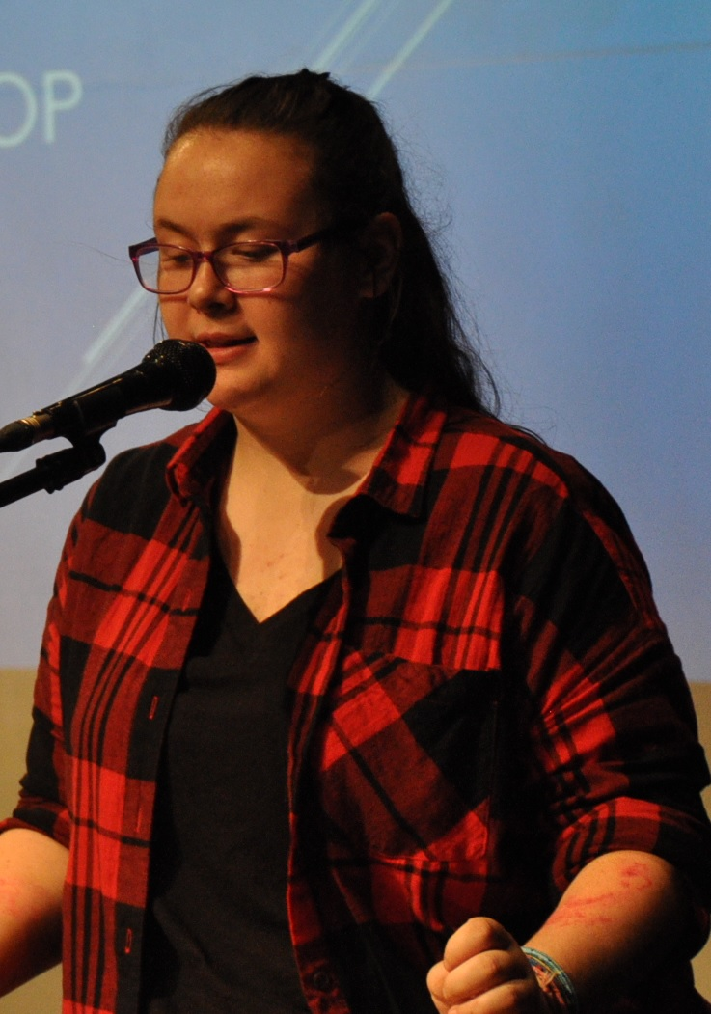
Negative team must accept AFF definitions, debate on those terms.
If it strongly disagrees with definitions, members can state their concerns in debate.
Judge will take this into consideration when scoring.
If negative team does not refute affirmative team arguments, it cannot win debate.

Slide 15
Traditionally speeches incorporate conventional language of debate as in: "Honourable judge, patient timekeeper, my worthy opponents, and my most esteemed colleague..."
Experienced debaters find creative ways to breathe new life into these phrases.
Speeches marked on tone, style, deportment, persuasiveness, eye contact, decorum (appropriate acknowledgement of audience).
15 seconds grace per speech.

Slide 17
15 second
grace period

Slide 18
Cross-examining the Witness
Examiner must ask direct questions; can refer to witness as "you," never by name.
Cannot make speeches in hopes that it will strengthen team's arguments.
Not allowed to simply demand "yes or no" answers; witness allowed to justify his/her answer.

Slide 19
Examiner cannot interrupt witness before he or she has had time to answer question.
However, after 30 seconds, examiner allowed to interject with "thank you".
Witness cannot ask questions; witness can ask examiner for clarification.

Slide 20
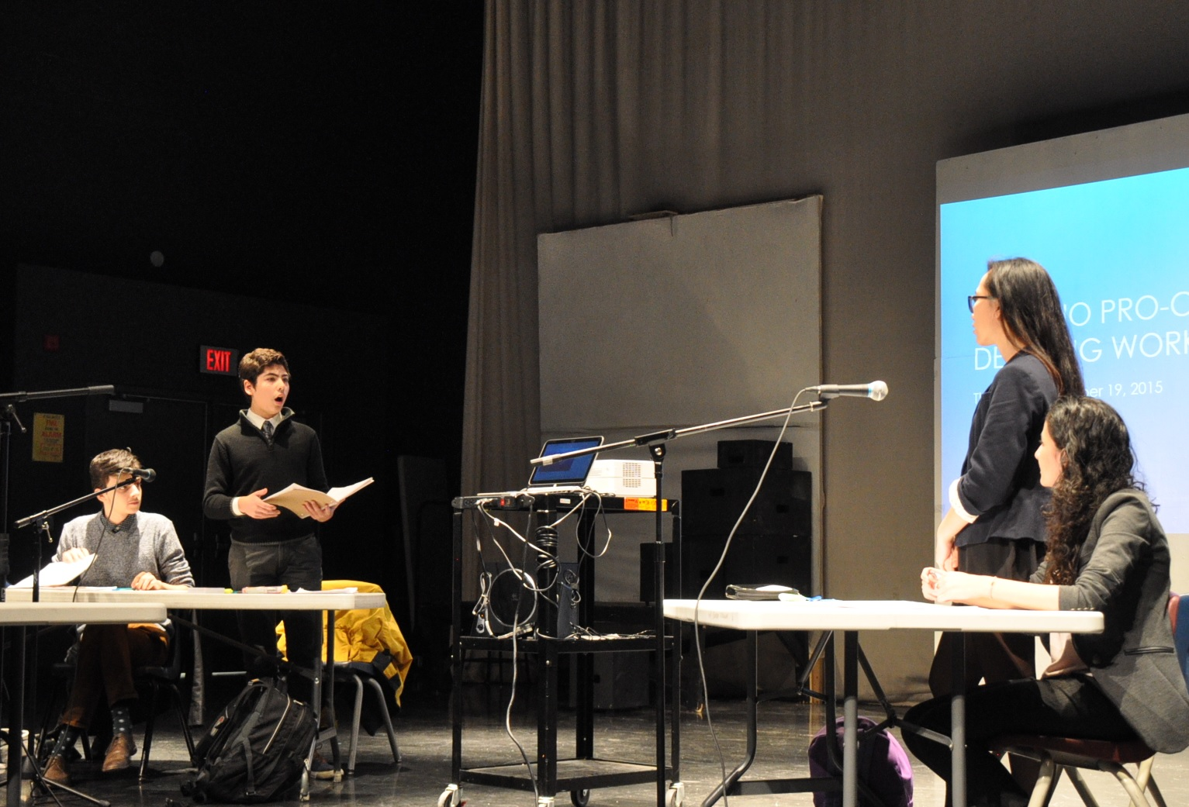
Debaters must act in a courteous, polite manner
Debaters must not attempt to belittle or insult opponents.
General rule: "Attack the point, not the person".
Heckling not allowed.

Slide 21
Specific Points of Interest for Judges
Be sure to complete 1 ballot for each round of debate that you judge.
Strive for impartiality.
We encourage students not to debate in school uniforms to maintain anonymity.
Judges are welcomed to jot down comments in order of speaking as the debate progresses.

Slide 22
What an Effective Speech Looks Like: Delivery (10 marks)
Fidgeting?
Folded arms or hands in pockets?
Talking too quickly?
Monotone voice?
Slouching or swaying?
Hesitating or stalling?
Minimal eye contact?
Dependent on notes?
Lack of energy?

Slide 23
Speech Content (20 marks)
"Road-mapping", reasoning, creativity, logic, validity of facts, refutation of opponents' arguments, decorum.
Only 1st Affirmative delivers pre-prepared speech; all other debaters must incorporate refutation based on information heard in debate.
Begin or end speech with refutation? How much of each subsequent speech should be devoted to thorough refutation? 30-50%.

Slide 24
Questioning (6 marks)
Are questions logical, relevant, concise, pointed, precise, and politely-worded? Does examiner avoid speech-making?
Examiners cannot force simple "yes or no" answers.
If examiners abruptly interrupt witnesses before they have had time to answer properly, then penalties will result; 30 second allowance for responses.
Examiner must not be discourteous or “badger the witness”; cannot interrupt an answer.
Witness must answer all questions as asked; penalized for evaded questions or perceived as “hostile witness”.
Witness cannot ask questions; can only ask examiner for clarification.

Slide 25
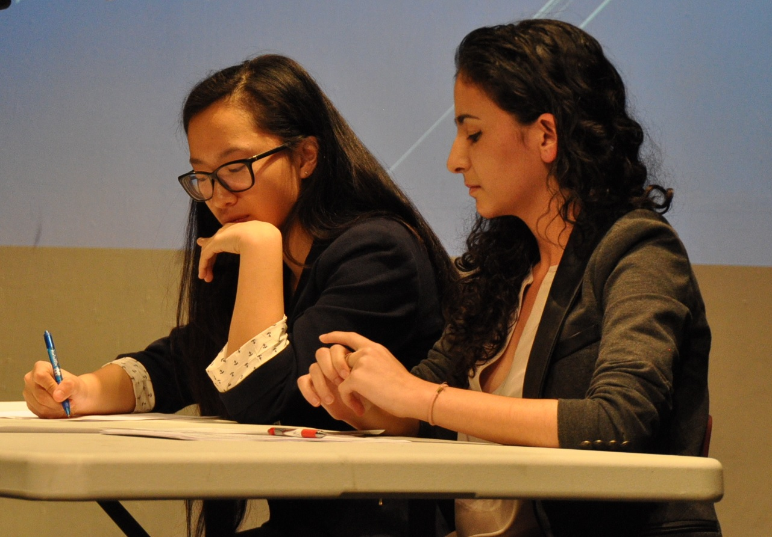
Answering (6 marks)
Witness allowed approximately 30 seconds to answer each question.
If response exceeds this, penalize witness for impeding examiner.
However, if examiner asks open-ended questions, witness can take as much time to respond as examiner will allow.
Witness cannot ask questions, except for clarification.

Slide 26
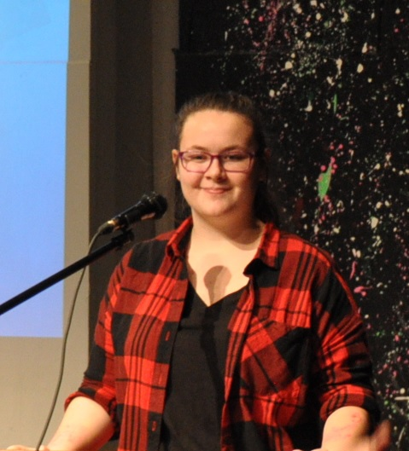
Rebuttals (8 marks)
No new information allowed.
Rebuttal speech not simply as summary of team’s points.
Teams should rebuild their case by contesting opponent’s criticisms of their arguments during speeches, cross-examination.

Slide 27
Scoring Chart
Score | Description | % of Scores
50 | Impossible
48 - 49 | Incredible, astounding | 0.5
45 - 47 | Excellent, superlative | 4
40 - 44 | Very good | 25
36 - 39 | Good, average | 45
33 - 35 | Satisfactory | 15
30 - 32 | Below average | 7
26 - 29 | Poor | 3
25 and under | Unprepared, violates rules | 0.5

Slide 28
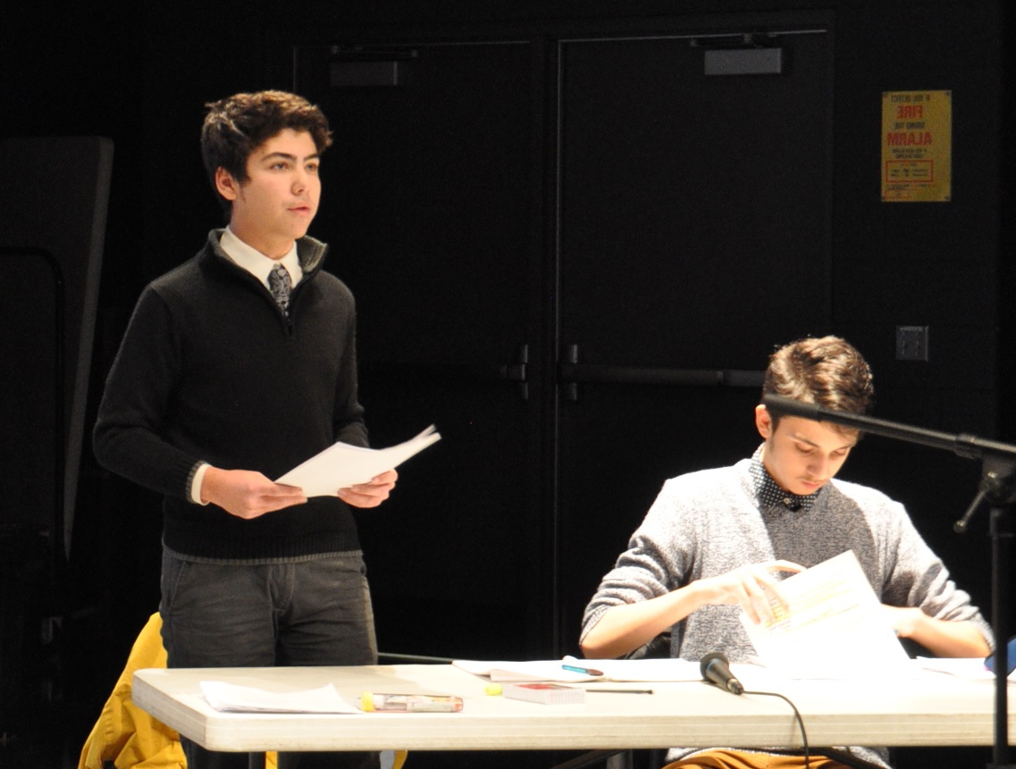
Impromptu Round Ends Debate Tournaments
Uses modified times: 4-minute speeches, 2-minute cross-ex; 2-minute rebuttals.
Emphasizes agility of thought, wit, humour, counter-toning strategy
Depth, breadth of factual evidence of less importance but...
In Pro-Con, topics are of a more light-hearted nature.
No electronic devices, help from coaches, or parents allowed.

Slide 29
General Tips

Slide 30
Speeches are Judged on Their Merits
Judges will not evaluate speeches for what has not been offered as arguments.
They can only judge arguments that have been presented.
Having said that, judges can note a debater’s ability or inability to critique opponents’ arguments.
Look for clear language and logic concepts that identify fallacies or rhetorical strategies.

Slide 31
After debate ends…
Judges should make oral comments after the debate.
Be detailed, descriptive, specific.
Avoid signs of inattentiveness like sleeping, texting or eating.
Judges stay behind if you have further questions.

Slide 32
Thank You for Your Generosity
Notes:
Thank you again for your generosity in volunteering.
It makes this tournament and the experience of debating possible for our students.

